Slide 1

Image Segmentation
Reference:
Digital Image Processing
Gonzalez & Woods

Slide 2
Segmentation
Segmentation subdivides an image into its constituent regions or objects. It attempts to:
  Partition an image into meaningful regions with respect to a particular application.
Segmentation is based on measurements taken from the image.
  Might be graylevel, colour, texture, depth or motion.
  It should stop when the objects of interest in an application have been isolated.

Slide 3
The Segmentation Problem
Segmentation algorithms are generally based on two basic properties of intensity values:
  Discontinuity, ex. used to detect edges
  Similarity, ex. thresholding, region growing
Applications of image segmentation include:
  Identifying objects in a scene for object-based measurements such as size and shape.
  Identifying objects in a moving scene for object-based video compression (MPEG4).
  Identifying objects which are at different distances from a sensor using depth measurements from a laser range finder enabling path planning for a mobile robot.

Slide 4
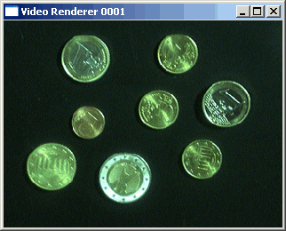
The Segmentation Problem
Segmentation attempts to:
  partition the pixels of an image into groups that strongly correlate with the objects in an image.
  Typically the first step in any automated computer vision application.

Slide 5


Segmentation Example
Example 1
  Segmentation based on greyscale.
  Very simple ‘model’ of grayscale leads to inaccuracies in object labelling.

Slide 6
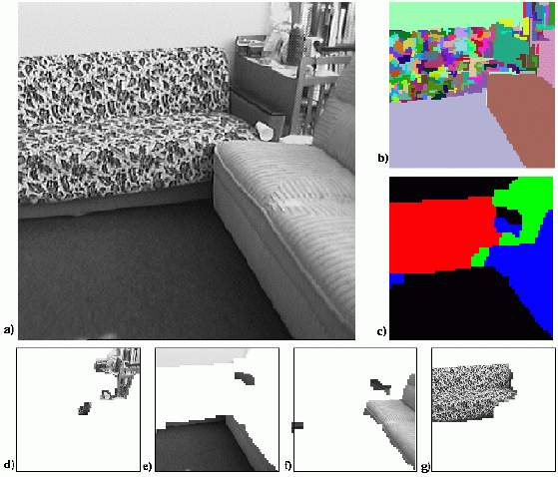
Segmentation Example
Example 2
  Segmentation based on texture.
  Enables object surfaces with varying patterns of grey to be segmented.

Slide 7
Detection Of Discontinuities
There are three basic types of grey level discontinuities in digital images:
  Points
  Lines
  Edges
We typically find discontinuities using masks and correlation.

Slide 8


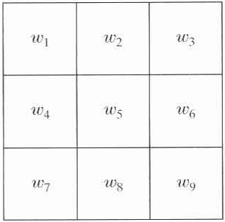

Detection Of Discontinuities
We say that a point, line and edge has been detected at the location on which the mask is centered if where,
and T is a non-negative threshold.
Images taken from Gonzalez & Woods, Digital Image Processing (2002)

Slide 9
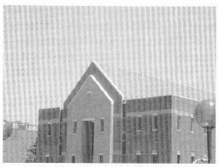
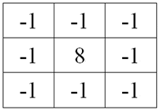
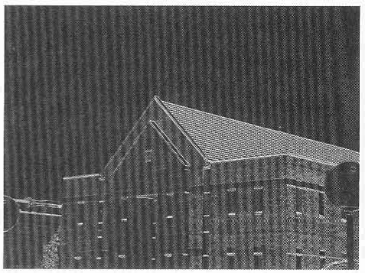
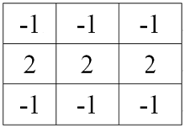
Detection Of Discontinuities
A point detection mask:
A line detection mask:
Images taken from Gonzalez & Woods, Digital Image Processing (2002)

Slide 10
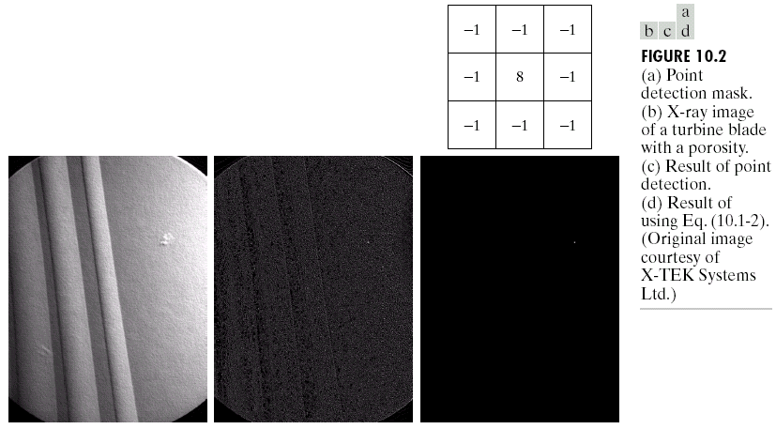
Point Detection
Point detection can be achieved simply by using the mask below:
Points are detected at those pixels in the subsequent filtered image that are above a set threshold.
Images taken from Gonzalez & Woods, Digital Image Processing (2002)

Slide 11
Point Detection
The formulation measures weighted differences between center point and its neighbours.
  An isolated point will be quite different from its background.
  Mask coefficients sum to zero, indicating that mask response will be zero in areas of constant gray level.
Images taken from Gonzalez & Woods, Digital Image Processing (2002)

Slide 12
Point Detection (cont…)
Images taken from Gonzalez & Woods, Digital Image Processing (2002)
X-ray image of a turbine blade
Result of point detection
Result of thresholding

Slide 13
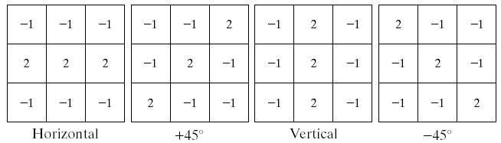
Line Detection
Methods:
  Use of Convolution Mask
  Hough Transform
The masks below will extract lines that are one pixel thick and running in a particular direction:
Images taken from Gonzalez & Woods, Digital Image Processing (2002)

Slide 14
Line Detection
Let R₁, R₂, R₃, R₄ be the mask responses, when they are run on an image given by equation:
If, at a certain point in the image, |R_{i}| > |R_{j}| for all j ≠ i, that point is more likely to be associated with a line in the direction of mask i.
Images taken from Gonzalez & Woods, Digital Image Processing (2002)

Slide 15
Line Detection
If we are interested in detecting all lines in an image in the direction defined by a given mask, we run the mask through the image and threshold the absolute value of the result.
  The points that are left are the strongest responses, one pixel thick, corresponding closest to the direction defined by the mask.
Images taken from Gonzalez & Woods, Digital Image Processing (2002)

Slide 16
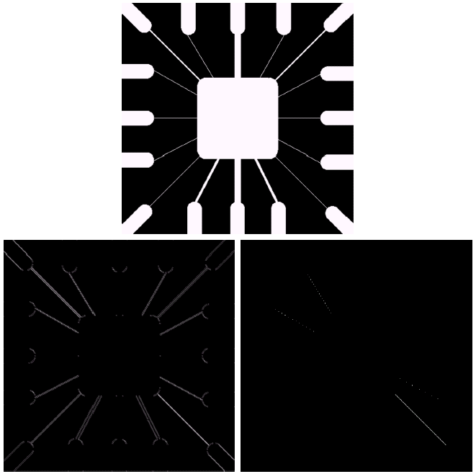
Line Detection
Binary image of a wire bond mask
Images taken from Gonzalez & Woods, Digital Image Processing (2002)
After processing with -45° line detector
Result of thresholding filtering result

Slide 17


Edge Detection
Edge - Area of significant change in the image intensity / contrast.
Edge Detection – Locating areas with strong intensity contrasts.
Use of Edge Detection – Extracting information about the image, e.g. location of objects present in the image, their shape, size, image sharpening and enhancement.
Images taken from Gonzalez & Woods, Digital Image Processing (2002)

Slide 18
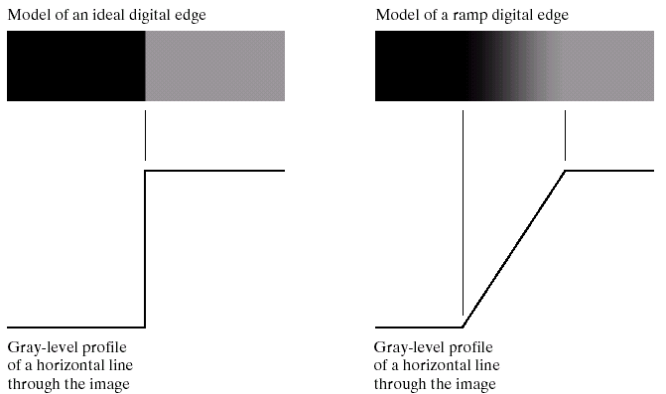
Edge Detection
An edge is a set of connected pixels that lie on the boundary between two regions.
Images taken from Gonzalez & Woods, Digital Image Processing (2002)

Slide 19
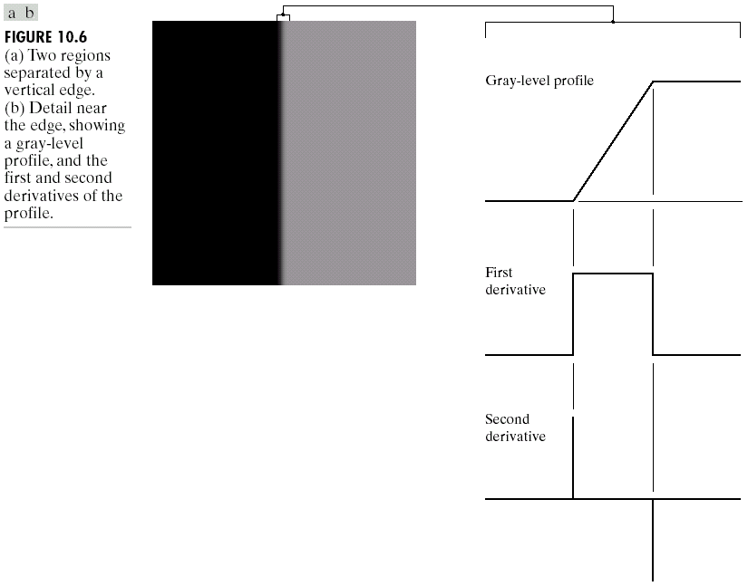
Edges & Derivatives
We have already spoken
about how derivatives
are used to find
discontinuities
1st derivative tells us
where an edge is
2nd derivative can
be used to show
edge direction
Images taken from Gonzalez & Woods, Digital Image Processing (2002)

Slide 20
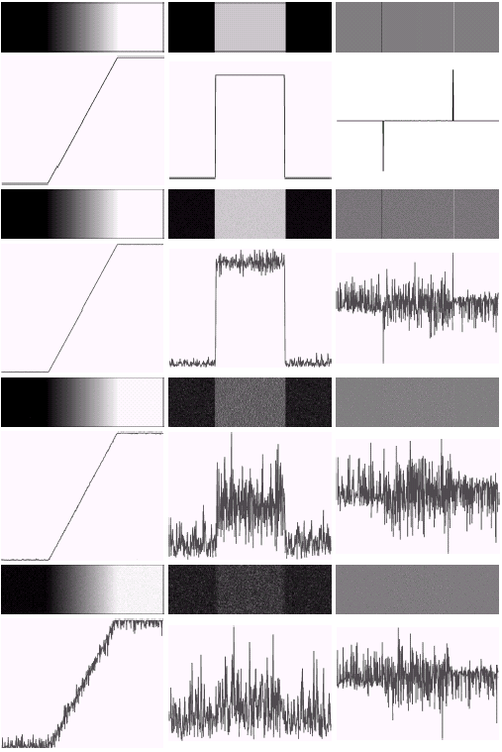
Derivatives & Noise
Derivative based edge detectors are extremely sensitive to noise
Images taken from Gonzalez & Woods, Digital Image Processing (2002)

Slide 21
Edges & Derivatives
First Order Derivative / Gradient Methods
  Roberts Operator
  Sobel Operator
  Prewitt Operator
Second Order Derivative
  Laplacian
  Laplacian of Gaussian
  Difference of Gaussian
Optimal Edge Detection
  Canny Edge Detection
Images taken from Gonzalez & Woods, Digital Image Processing (2002)

Slide 22
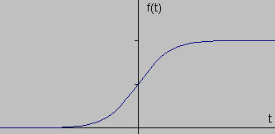
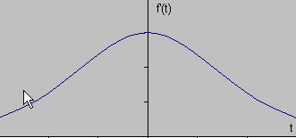
First Derivative
At the point of greatest slope, the first derivative has maximum value.
Images taken from Gonzalez & Woods, Digital Image Processing (2002)

Slide 23
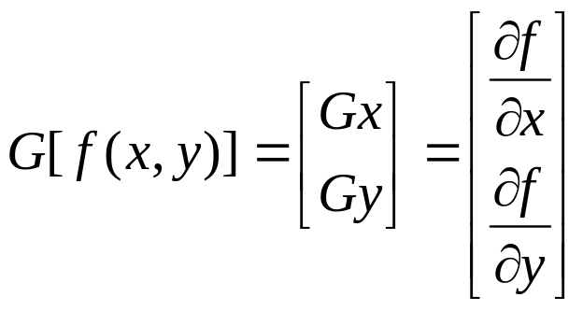
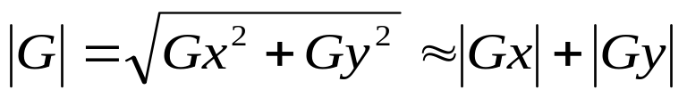
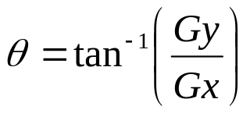
First Derivative
For a continuous two dimensional function gradient is defined as:
Images taken from Gonzalez & Woods, Digital Image Processing (2002)

Slide 24

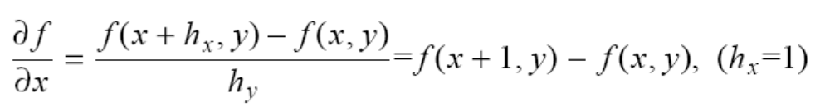
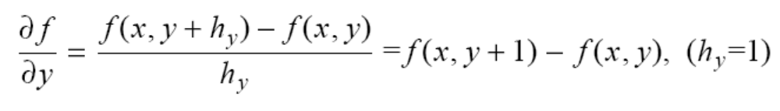
Gradient
Images taken from Gonzalez & Woods, Digital Image Processing (2002)

Slide 25
Gradient
Convolution Mask:
  Gx =
  Gy =
-1 | 1
-1 | 1
-1 | 1
Images taken from Gonzalez & Woods, Digital Image Processing (2002)
1
-1
1 | 1
-1 | -1

Slide 26
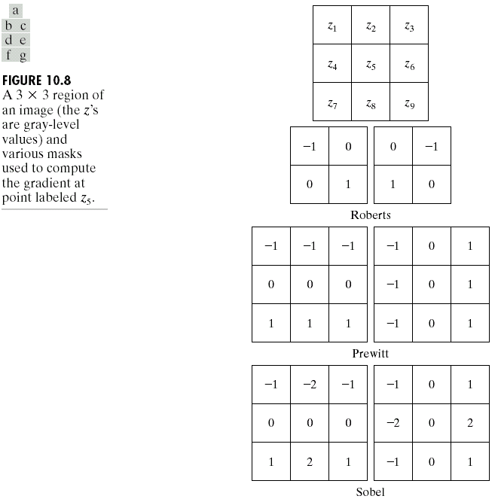
Common Edge Detectors
Given a 3*3 region of an image, the following edge detection filters can be used:
Images taken from Gonzalez & Woods, Digital Image Processing (2002)

Slide 27
Roberts Operator
Provides an approximation to the gradient
Convolution Mask:
  Gx =
  Gy =
1 | 0
0 | -1
Images taken from Gonzalez & Woods, Digital Image Processing (2002)
0 | -1
1 | 0

Slide 28
Sobel Operator
The 3x3 convolution mask smoothes the image by some amount , hence it is less susceptible to noise.
  But it produces thicker edges. So edge localization is poor.
Convolution Mask:
  Gx = Gy =
The differences are calculated at the center pixel of the mask.
-1 | 0 | 1
-2 | 0 | 2
-1 | 0 | 1
1 | 2 | 1
0 | 0 | 0
-1 | -2 | -1
Images taken from Gonzalez & Woods, Digital Image Processing (2002)

Slide 29
Prewitt Operator
It is similar to the Sobel operator but uses slightly different masks.
Convolution Mask:
  Gx =
  Gy =
-1 | 0 | 1
-1 | 0 | 1
-1 | 0 | 1
Images taken from Gonzalez & Woods, Digital Image Processing (2002)
1 | 1 | 1
0 | 0 | 0
-1 | -1 | -1

Slide 30

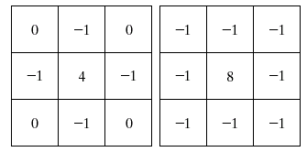
Laplacian Edge Detection
Laplacian is a 2nd-order derivative based filter defined as:
Mask:
  The Laplacian is typically not used by itself as it is too sensitive to noise. Usually, the Laplacian is combined with a smoothing Gaussian filter.
Images taken from Gonzalez & Woods, Digital Image Processing (2002)

Slide 31
MORPHOLOGICAL IMAGE PROCESSING

Slide 32
Introduction
What is morphology or morphological image processing?
  describes a range of image processing techniques that deal with the shape (or morphology) of features in an image
  Morphological operations are typically applied to remove imperfections introduced during segmentation, and so typically operate on bi-level images

Slide 33
Introduction
Morphological image processing is used to:
  extract image components for representation and description of region shape, such as boundaries, skeletons, and the convex hull.
  edge detection, noise removal, image enhancement and image segmentation.
Morphological techniques probe an image with a small shape or template known as a structuring element.
  The structuring element is positioned at all possible locations in the image.
  It is compared with the corresponding neighborhood of pixels.
  Morphological operations differ in how they carry out this comparison.

Slide 34
Basic Set Theory (1)
If a=(a1,a2) is an element of A: a∈ A
If a is not an element of A : a∉ A
The set with no elements is called the null or empty set and is denoted by the symbol ∅.
If every element of a set A is also an element of another set B, then a is said to be a subset of B: A ⊆ B
The union of two sets A and B is the set of all elements belonging to either A,B or both: C=A∪ B
The intersection of two sets A and B is the set of all elements belonging to both A and B: D=A ∩ B
Two sets A and B are disjoint or mutually exclusive if they have no common elements. A ∩ B = ∅

Slide 35
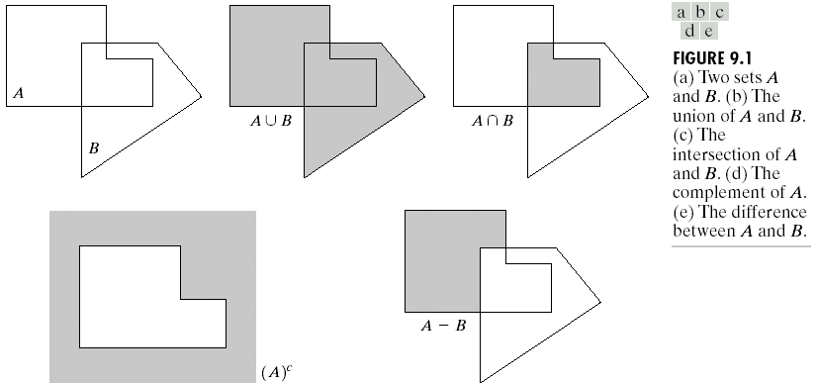
Basic Set Theory (1)

Slide 36
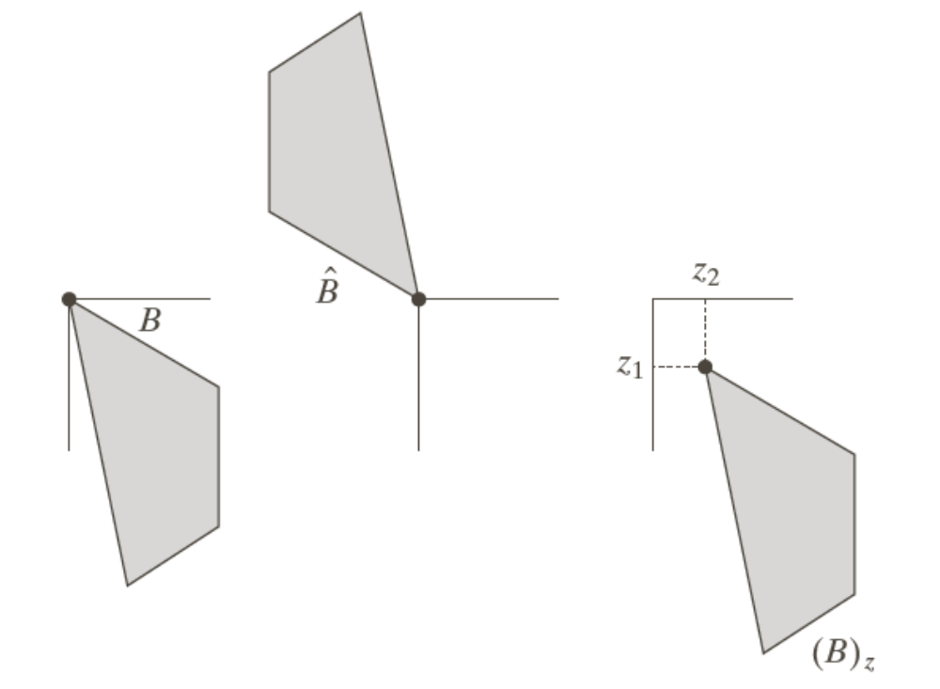
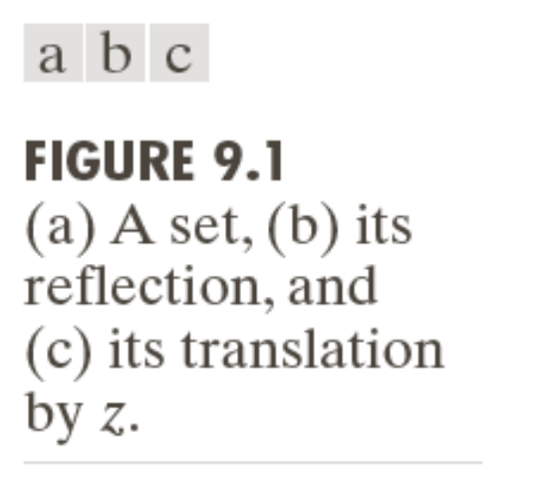
Example: Reflection and Translation

Slide 37
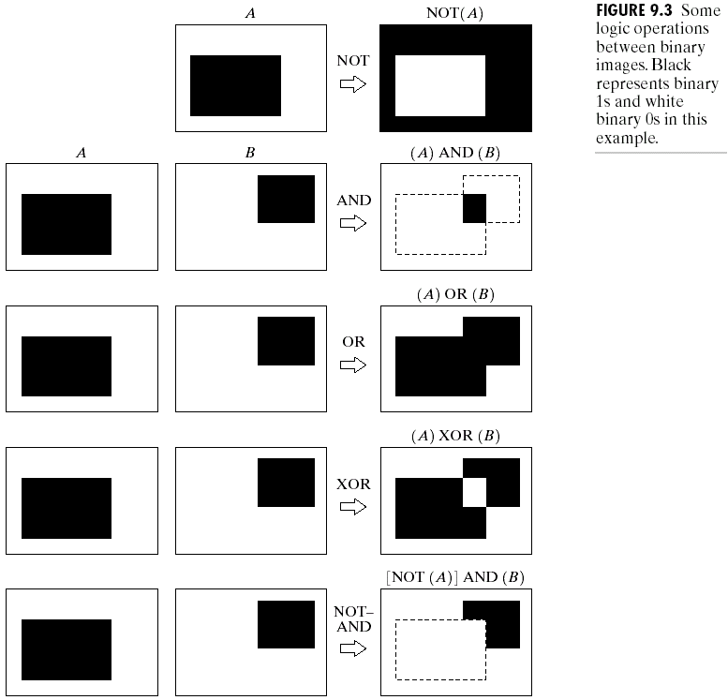
Logic Operations

Slide 38
Preliminaries (6)
Structuring elements (SE)
  Small sets or sub-images used to probe an image under study for properties of interest.
  Consists of a pattern specified as the coordinates of a number of discrete points relative to some origin.
  A convenient way of representing the element is as a small image on a rectangular grid.
  The origin does not have to be in the center of the structuring element, but often it is.
  Structuring elements that fit into a 3×3 grid with its origin at the center are the most commonly seen type.

Slide 39
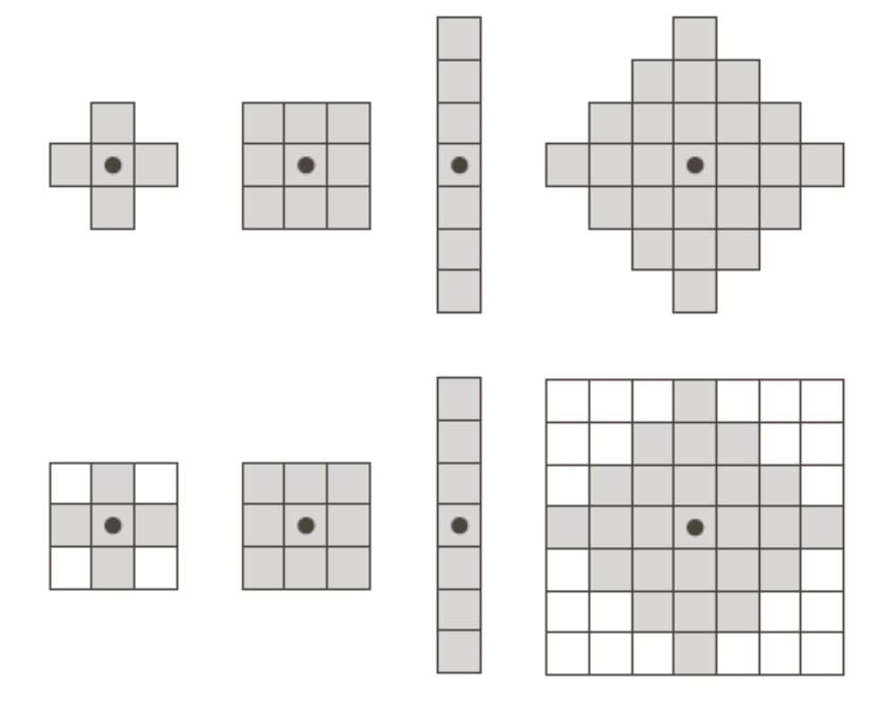
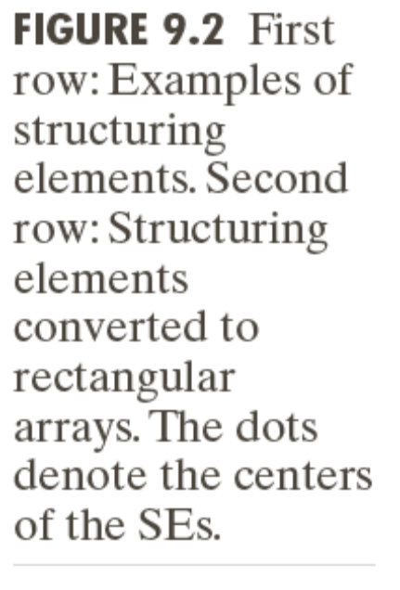
Examples: Structuring Elements (1)
origin

Slide 40
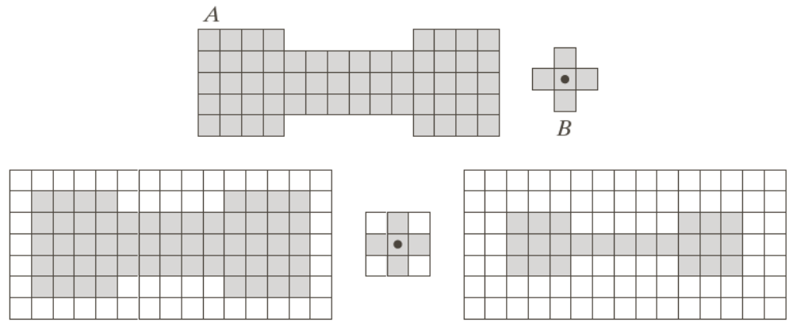
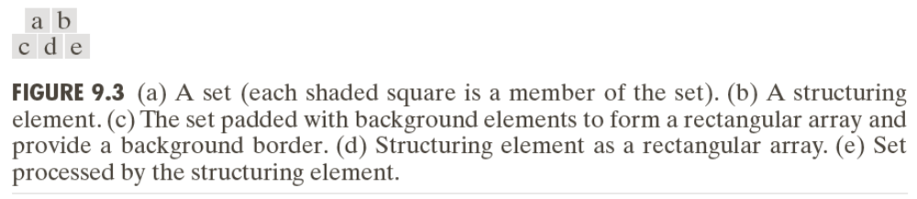

Examples: Structuring Elements (2)
Accommodate the entire structuring elements when its origin is on the border of the original set A
Origin of B visits every element of A
At each location of the origin of B, if B is completely contained in A, then the location is a member of the new set, otherwise it is not a member of the new set.

Slide 41
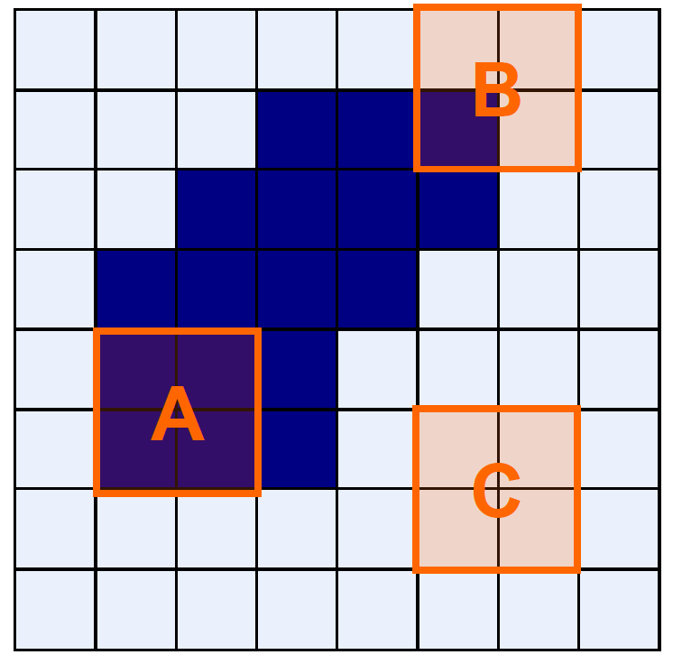
Structuring Elements (Hits and Fits)
Fit: All one pixels in the
structuring element
cover one pixels in the
image
Hit: Any one pixel in the
structuring element
covers any one pixel in the
image

Slide 42


Basic Morphological Operations
Erosion
Dilation
Combine to: Keep general shape but smooth w.r.t.
  Opening Object
  Closing Background

Slide 43
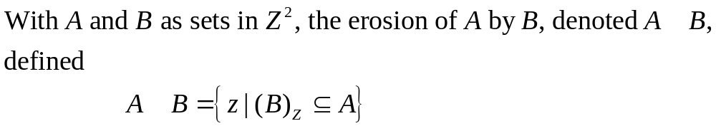

Erosion
Does the structuring element fit the set?

Slide 44
Erosion: How it works
For each foreground pixel, superimpose the structuring element on the input image such that the origin of the structuring element coincides with the input pixel coordinates.
If for every pixel in the structuring element, the corresponding pixel in the image underneath is a foreground pixel, then the input pixel is left as it is.
If any of the corresponding pixels in the image are background, however, the input pixel is also set to background value.

Slide 45
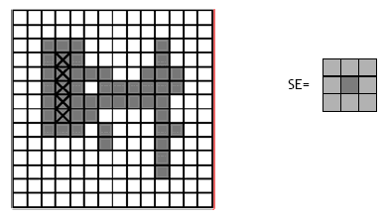
Erosion: How it works

Slide 46
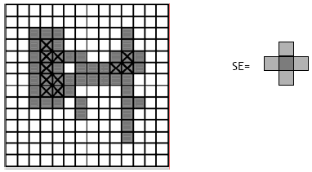
Erosion: How it works

Slide 47
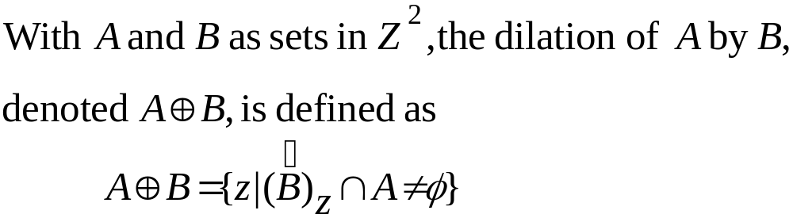
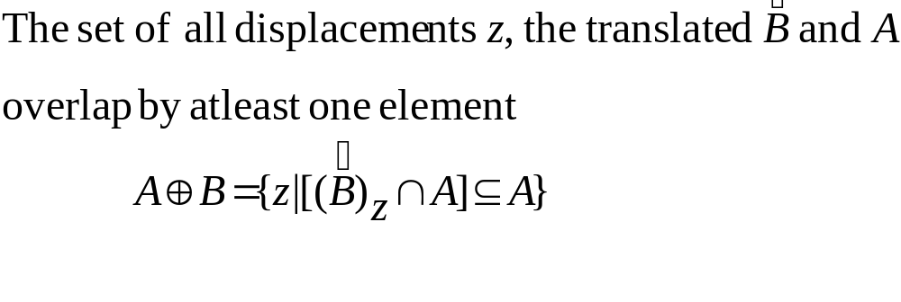
Dilation
Does the structuring element hit the set?

Slide 48
Dilation: How it works
For each background pixel (which we will call the input pixel) we superimpose the structuring element on top of the input image so that the origin of the structuring element coincides with the input pixel position.
If at least one pixel in the structuring element coincides with a foreground pixel in the image underneath, then the input pixel is set to the foreground value.
If all the corresponding pixels in the image are background, however, the input pixel is left at the background value.

Slide 49
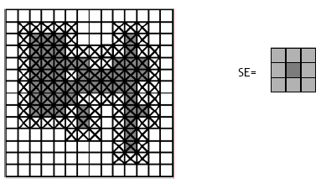
Dilation: How it works

Slide 50
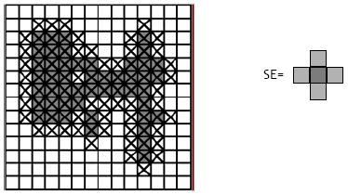
Dilation: How it works

Slide 51
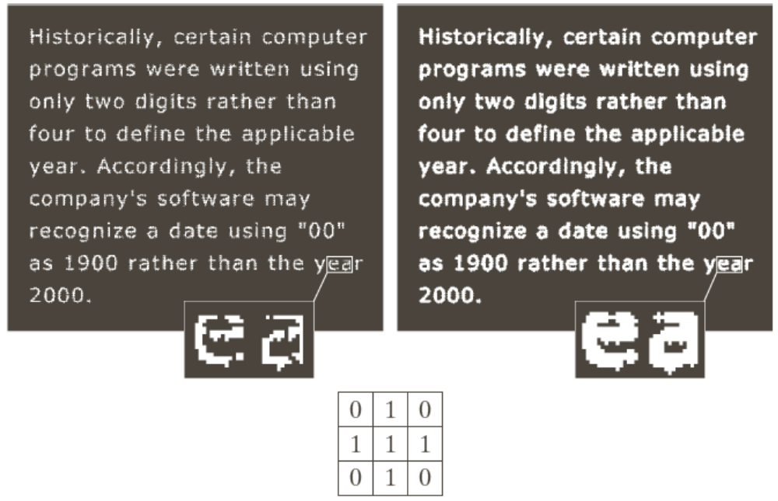
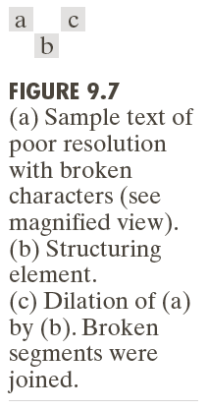
Example of Dilation
Examples of Dilation

Slide 52
Opening and Closing
Opening generally smoothes the contour of an object, breaks narrow isthmuses, and eliminates thin protrusions.
Closing tends to smooth sections of contours but it generates fuses narrow breaks and long thin gulfs, eliminates small holes, and fills gaps in the contour.

Slide 53
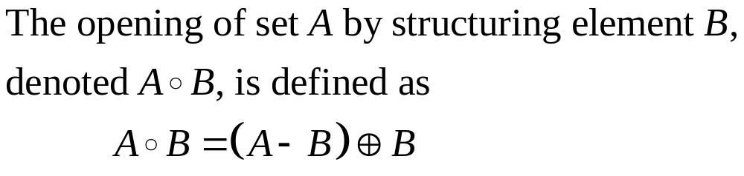
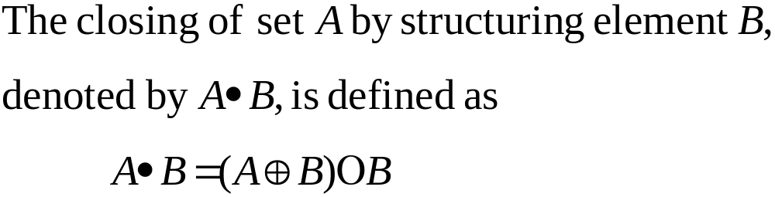
Opening and Closing

Slide 54
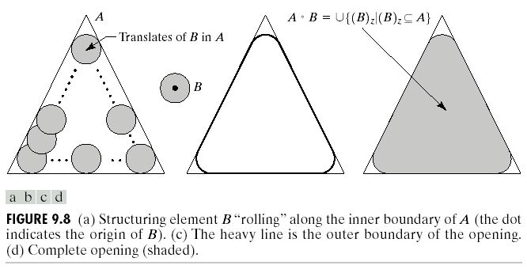
Opening

Slide 55
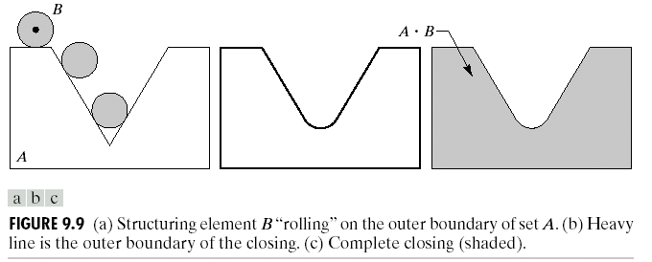
Closing

Slide 56
Representation

Slide 57
Representation
Image regions (including segments) can be represented by either the border or the pixels of the region. These can be viewed as external or internal characteristics, respectively.
Chose a representation scheme:
  Chain codes (4- and 8-directional chain codes)
  Signature (1-D functional representation)
  Skeleton of a region – morphological operator
Describe the region based on the scheme:
  Boundary descriptors
    Length, diameter, shape numbers, Fourier descriptors
    Moments of signatures
  Region descriptors
    Area, compactness, principal axes
    Texture
    Moment

Slide 58
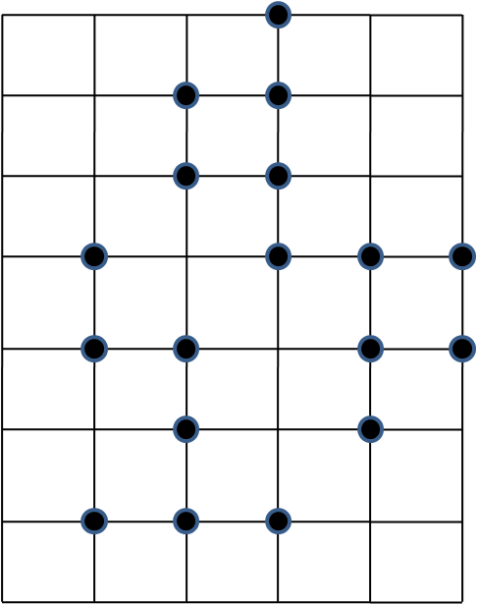
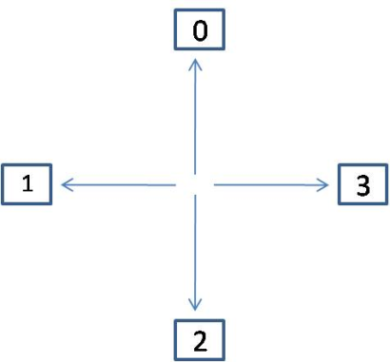
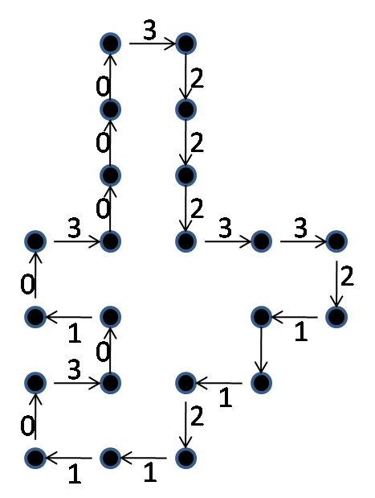
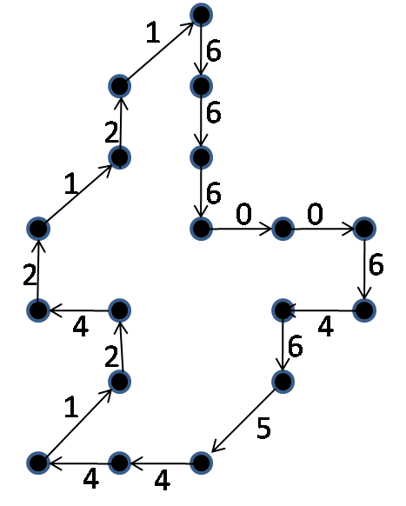
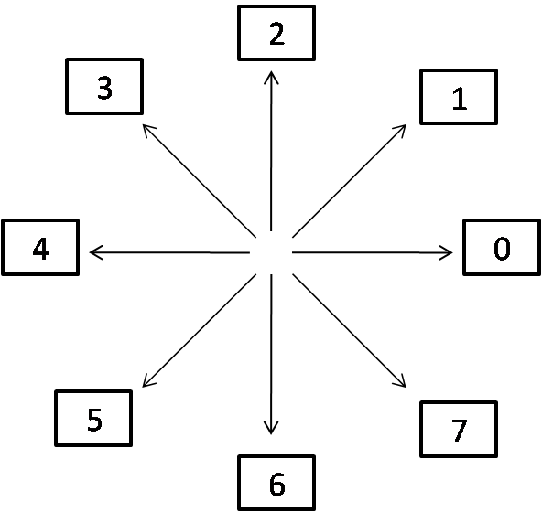
Chain Code
Chain codes: represent the boundary of a connected region.

Slide 59
Chain Codes
Chain codes can be based on either 4-connectedness or 8-connectedness.
The first difference of the chain code:
  This difference is obtained by counting the number of direction changes (in a counterclockwise direction)
  For example, the first difference of the 4-direction chain code 10103322 is 3133030.
Assuming the first difference code represent a closed path, rotation normalization can be achieved by circularly shifting the number of the code so that the list of numbers forms the smallest possible integer.
Size normalization can be achieved by adjusting the size of the resampling grid.

Slide 60
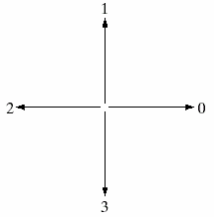


Shape Numbers
The shape number of a boundary is defined as the first difference of smallest magnitude.
The order n of a shape number is defined as the number of digits in its representation.
First difference

Slide 61

Shape Numbers

Slide 62
Signature
The idea behind a signature is to convert a two dimensional boundary into a representative one dimensional function.
Signatures are invariant to location, but will depend on rotation and scaling.
  Starting at the point farthest from the reference point or using the major axis of the region, can be used to decrease dependence on rotation.
  Scale invariance can be achieved by either scaling the signature function to fixed amplitude or by dividing the function values by the standard deviation of the function.

Slide 63


Signature
Distance signature of circle shapes
Distance signature of rectangular shapes

Slide 64
Boundary Descriptors
There are several simple geometric measures that can be useful for describing a boundary.
  The length of a boundary: the number of pixels along a boundary gives a rough approximation of its length.
  Curvature: the rate of change of slope.
    To measure a curvature accurately at a point in a digital boundary is difficult.
    The difference between the slopes of adjacent boundary segments is used as a descriptor of curvature at the point of intersection of segments.

Slide 65
Boundary Descriptors
Length of boundary is simplest descriptor.
  For a chain-coded curve with unit spacing in both directions, the number of vertical and horizontal components plus √2 times the number of diagonal components gives exact length.
  Diameter of boundary B is defined as:
  Diam(B ) = max[D (p_{i} ,p_{j})]
  where, D is a distance measure and p_{i}, p_{j} are points on boundary.
  Line segment connecting the two extreme points of diameter is called major axis.
  Line perpendicular to major axis is called minor axis.

Slide 66
Boundary Descriptors
A box passing through the outer four points of intersection of boundary with major and minor axes, completely encloses the boundary. This box is called basic rectangle.
Ratio of major to minor axis is called eccentricity of boundary.
Rate of change of slope is curvature.
  Difference between slopes of adjacent boundary segments can also be used.

Slide 67
Regional Descriptors
Some simple descriptors
  The area of a region: the number of pixels in the region
  The perimeter of a region: the length of its boundary
  The compactness of a region: (perimeter)²/area
  The mean and median of the gray levels
  The minimum and maximum gray-level values
  The number of pixels with values above and below the mean

Slide 68


Regional: Topological Descriptors
Useful for global descriptions of regions in the image plane, for ex.:
  Number of holes
  Number of connected components

Slide 69


Regional: Topological Descriptors
E = V - Q + F = C – H
  E: Euler number
  V: the number of vertices
  Q: the number of edges
  F: the number of faces
  C: the number of
  connected component
  H: the number of holes

Slide 70
Regional Descriptors: Texture
Texture is usually defined as the smoothness or roughness of a surface.
In computer vision, it is the visual appearance of the uniformity or lack of uniformity of brightness and color.
Basic elements that describe the texture are sometimes called texels.
Broadly, there are two types of texture: random and regular.
  Random texture cannot be exactly described by words or equations; it must be described statistically. The surface of a pile of dirt or rocks of many sizes would be random.
    Random texture is analyzed by statistical methods.
  Regular texture can be described by words or equations or repeating pattern primitives. Clothes are frequently made with regularly repeating patterns.
    Regular texture is analyzed by structural or spectral (Fourier) methods.

Slide 71

Regional Descriptors: Texture
Three different textures with the same distribution of black and white.
The statistics of the distribution of pixel values cannot describe texture well. The spatial relationship among pixels should be used to describe texture.

Slide 72
Regional Descriptors: Quad Tree
Region Quadtree:
  a tree representation which represents recursive subdivisions of an image.
- Whose blocks are required to be disjoint.
- To have standard sizes (squares whose sides are power of two).
- To be at standard locations.
- Based on successive subdivision of image array into four equal size quadrants.

Slide 73
Regional Descriptors: Quad Tree
1
2
3
A
4
5
NW
NE
SW
SE
6
7
8
13
14
9
10
11
12
15
16
19
1
B
C
F
17
18
2
3
4
5
6
D
11
12
13
14
E
19
7
8
9
10
15
16
17
18

Slide 74
THE END

